Slide 1
Cancer Cells
Cancer is a disease that arises from abnormalities of cell function.
Gene mutations and changes in gene expression play a central role in cancer.

Slide 2
26.1 How Cancers Arise
Cancers are grouped into several categories.
Carcinomas (about 90% of all cancers) arise from epithelial cells covering external and internal body surfaces. Examples include lung, breast, and colon cancer.
Sarcomas develop from supporting tissues, bone, cartilage, fat, and muscle.

Slide 3
Types of Cancers
Lymphomas and leukemias arise from cells of blood and lymphatic origin.
Lymphomas are tumors that grow as a solid mass.
Leukemias proliferate mainly in the bloodstream.

Slide 4
Tumors Arise When the Balance Between Cell Division and Cell Differentiation or Death Is Disrupted
A cancer is a type of growth in which some cells divide and accumulate in an uncontrolled way.
The resulting mass of tissues is called a tumor (or neoplasm).
The crucial issue is not the rate of division but rather the balance between cell division and cell differentiation or cell death.

Slide 5
Cell Differentiation
Cell differentiation is the process by which cells acquire specialized properties.
As cells acquire these specialized traits, they often lose the capacity to divide.

Slide 6
Cell Differentiation in Skin
New cells continually replace aging cells shed from the outer body surface.
New cells are generated by cell divisions in the basal layer of the skin.
When a basal cell divides, it gives rise to two cells:
One stays in the basal layer and can still divide.
One differentiates and moves toward the skin surface.

Slide 7
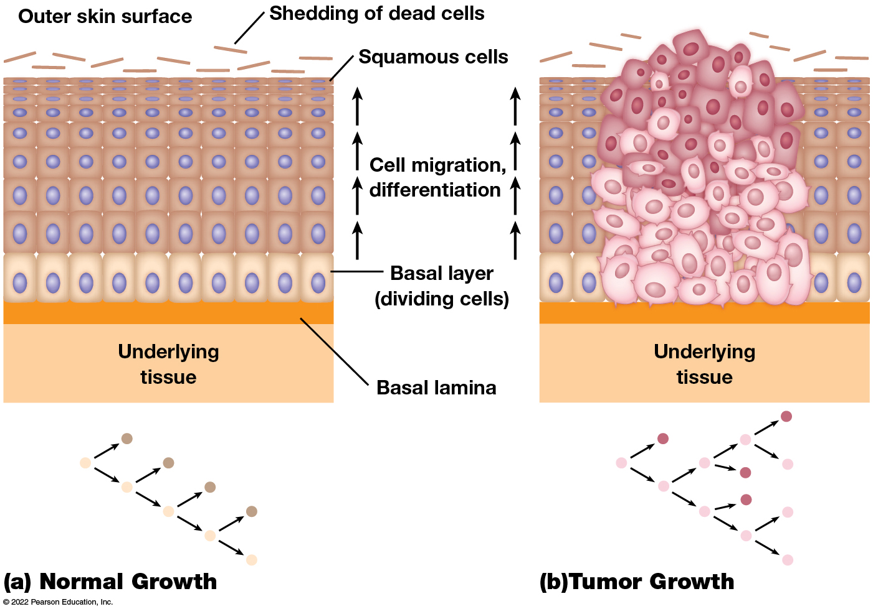
Comparison of Normal and Tumor Growth in the Epithelium of the Skin
Figure 26.1 Comparison of Normal and Tumor Growth in the Epithelium of the Skin.
Notes:
Long Description:
The details are as below:
Normal growth
Shedding of dead cells happens just below the outer skin surface.
Below the outer skin surface are squamous cells, a basal layer of undividing cells, basal lamina, and underlying tissue in this sequence.
The cells below the surface are arranged neatly in rows and columns, one above the other.
Cell division in basal layer gives rise to one cell above.
Cell migration and differentiation happen from the basal layer to the surface.
Only the cells in the basal layer with the capacity to divide are shaded in light color and look elongated in the illustration.
The cells above it are in dark and shorter as they go higher thawth:
t do not divide.
Tumor growth:
The cell death does not happen appropriately and cells protrude above the outer surface of skin.
The cells below the surface are not arranged neatly in rows and columns; they are all over.
Cell division in basal layer gives rise to multiple cells above.
Cell migration and differentiation happen from the basal layer to the surface.
The cells in the basal layer and above too with the capacity to divide are shaded in light color and look elongated in the illustration.
Certain cells in dark shade and shorter do not divide.

Slide 8
Balance Between Division and Differentiation
In normal skin, one of the two cells produced by each division stays in the basal lamina and retains the ability to divide. The other cell leaves the basal layer, loses the ability to divide, and finally dies.
A similar pattern is seen in the gastrointestinal tract lining and the bone marrow. This ensures no increase in number of dividing cells.
Cell division is carefully balanced with cell differentiation and death.

Slide 9
Disruption of Balance
In tumors, cell division is uncoupled from cell differentiation and death.
Some cell divisions give rise to two cells that can both continue to divide.
Regardless of how fast or a slow the cells divide, the tumor will continue to grow as new cells are produced in greater numbers than needed.

Slide 10
Types of Tumors
Benign tumors grow in a confined local area and are rarely dangerous.
Malignant tumors are capable of invading surrounding tissues and spreading to distant parts of the body.
The term cancer refers to any malignancy, in particular, malignant cells that can spread to new locations.

Slide 11
Cancer Cell Proliferation Is Anchorage Independent and Insensitive to Population Density
Cancer cells have particular traits, such as the ability to form tumors.
This can be demonstrated by injecting cells into nude mice, which lack an immune system.
Normal human cells injected into these won’t grow, whereas cancer cells will proliferate and form tumors.

Slide 12
Anchorage-Independent Growth
Normal cells do not grow well in culture unless provided with a solid surface they can attach to.
In contrast, cancer cells grow well not only when anchored to a solid surface but also when suspended in liquid or semisolid medium.
Cancer cells are thus said to exhibit anchorage-independent growth.

Slide 13
Anchorage-Independent Growth and Integrins
In the body, normal cells meet the anchorage requirement by binding to the extracellular matrix via integrins.
Attachment to the matrix can be prevented by blocking the binding of integrins to the matrix.
In this case, normal cells lose the ability to divide and often self-destruct by apoptosis.
Cancer cells circumvent this safeguard.

Slide 14
Density-Dependent Inhibition of Growth
Normal cells grown in culture divide until the surface of the vessel is covered by a single layer of cells.
Once this monolayer stage is reached, cell division stops, called density-dependent inhibition of growth.
Cancer cells will continue to divide and pile up upon one another, lacking sensitivity to density-dependent inhibition.

Slide 15
Cancer Cells Are Immortalized by Mechanisms That Maintain Telomere Length
Normal cells grown in culture divide a limited number of times.
Under similar conditions, cancer cells exhibit no such limit and continue dividing indefinitely.
HeLa cells were collected from Henrietta Lacks and are a uterine cervical cancer cell that were isolated in 1951 and have been dividing in culture for more than 70 years.

Slide 16
Telomeres
Telomere D N A sequences are lost from the ends of each chromosome whenever D N A replicates.
If a cell divides too many times, the telomeres are too short to protect the ends of chromosomes and apoptosis is triggered.
Most cancer cells produce telomerase, the enzyme that adds telomere sequences to the ends of D N A molecules. Cancer cells can use other methods to ensure the telomeres length.

Slide 17
Defects in Signaling Pathways, Cell Cycle Controls, and Apoptosis Contribute to Cancer
Mechanisms to maintain telomere length allow cancer cells to continue dividing, but they do not cause the cell to divide.
Cells do not usually divide unless stimulated by the proper growth factor.
Cancer cells circumvent this by altering signaling pathways, creating a constant signal to divide.
Disruption of cell cycle control also contributes to cancer cell proliferation.

Slide 18
Restriction Point
Normal cells grown under suboptimal conditions become arrested at the restriction point and stop dividing.
The restriction point controls progression from G1 into S phase.
Cancer cells do not respond appropriately to external signals and to internal conditions that would normally trigger a halt to the cell cycle.

Slide 19
Apoptosis
For some cancers, uncontrolled growth is due to a failure to undergo apoptosis, rather than to increased cell division.
Cancer cells are able to block the pathways that trigger apoptosis in various ways.

Slide 20
Cancer Arises Through a Multistep Process Involving Initiation, Promotion, and Tumor Progression
Cancer development requires multiple steps.
Normal cells are converted into a precancerous state and sensitized to further change in a process called initiation.
During the long, gradual process of promotion, sensitized cells are repeatedly exposed to cancer-promoting agents.

Slide 21
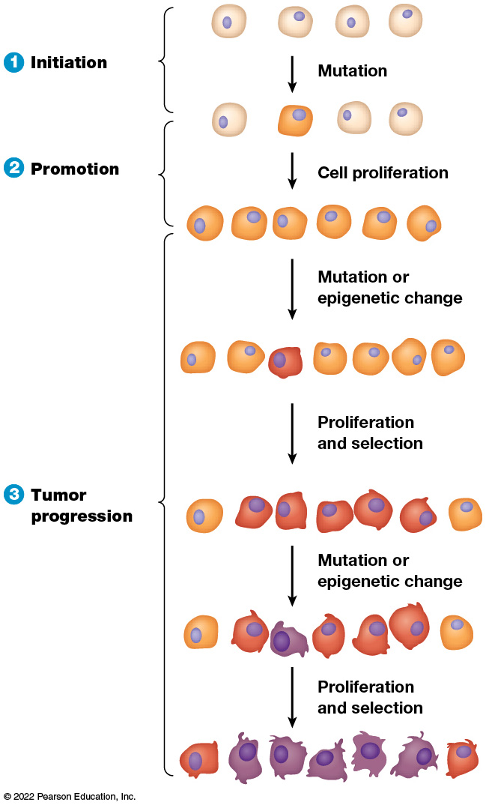
Main Stages in Cancer Development
Figure 26.3 Main Stages in Cancer Development.
Notes:
Long Description:
The different stages are as below indicated in different color shades of cells:
Initiation: There are four light shaded cells. Mutation occurs in one of the cells and is in darker shade.
Promotion:
The one mutated cell undergoes cell proliferation and become six cells in the same shade of color.
Mutation or epigenetic change occurs in the six cells that give rise to 7 cells where one cell is in deep red shade.
Proliferation and selection happens and the red cell gives rise to multiple such cells.
Tumor progression:
Mutation or epigenetic change occurs where a red cell gives rise to purple cell as well.
Proliferation and selection of such purple cells gives rise to multiple such purple cells.
The initial light colored cells are almost spherical in shape. The darker ones are slightly disoriented in shape. The red ones show protrusions as stages develop. The purple ones are highly disoriented in shape with multiple protrusions on the cells.

Slide 22
26.2 How Cancers Spread
Benign tumors remain in their original location and are usually easy to remove.
The hazards of cancer come from uncontrolled proliferation combined with the ability to spread throughout the body.
Roughly 90% of cancer deaths are caused by the spread of the cancer rather than the primary tumor.

Slide 23
Angiogenesis Is Required for Tumors to Grow Beyond a Few Millimeters in Diameter
In 1971, Judah Folkman suggested that tumors release signaling molecules that trigger angiogenesis, and the new blood vessels are needed for tumors to grow.
Laboratory experiments confirmed this.

Slide 24
Angiogenesis
The action of M M Ps allows endothelial cells to migrate into the surrounding tissues.
They become organized into hollow tubes and develop into new blood vessels.
V E G F and F G F must overcome angiogenesis inhibitors in order to promote blood vessel formation.

Slide 25
Angiogenesis Inhibitors
Many naturally occurring inhibitors of angiogenesis are known.
These include angiostatin, endostatin, and thrombospondin.
When tumors trigger angiogenesis, it is accomplished by increasing angiogenesis activators and decreasing angiogenesis inhibitors.

Slide 26
Cancer Cells Spread by Invasion and Metastasis
Invasion is the direct migration and penetration of cancer cells into neighboring tissues.
Metastasis involves the ability of cancer cells to enter the bloodstream and travel to distant sites.
Tumors formed in new locations are called metastases.

Slide 27
Metastasis
A cascade of events is required for a tumor to metastasize, beginning with angiogenesis.
First, cancer cells invade surrounding tissues and gain access to the bloodstream.
Second, they are transported throughout the body.
Third, they leave the bloodstream and establish new metastatic tumors in various organs.

Slide 28
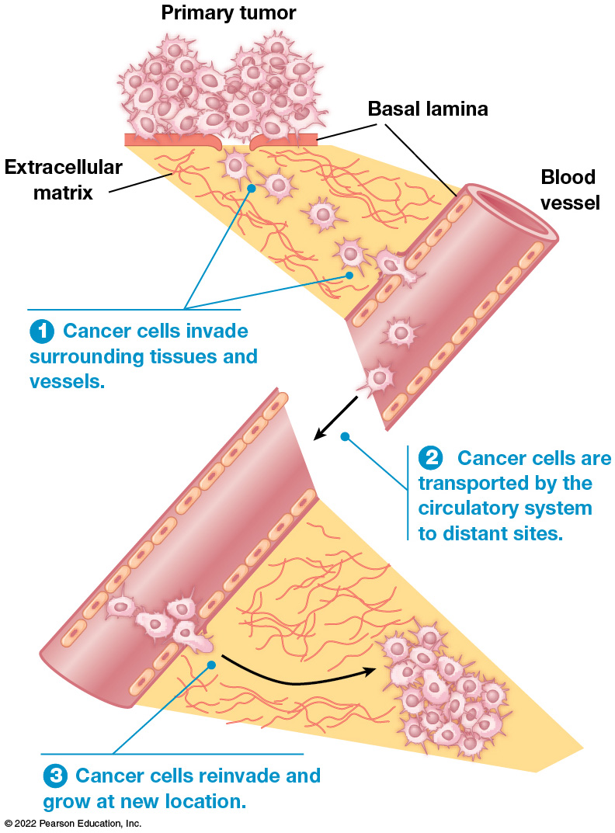
Stages in the Process of Metastasis
Figure 26.5 Stages in the Process of Metastasis.
Notes:
The details of the steps are as below:
Cancer cells invade surrounding tissues and vessels.
Cancer cells are transported by the circulatory system to distant sites.
Cancer cells reinvade and grow at new location.

Slide 29
Changes in Cell Adhesion, Motility, and Protease Production Promote Metastasis
The first step in metastasis involves invasion of surrounding tissues and vessels.
Cell-cell adhesion proteins that cause cells to adhere to one another are often missing or defective in cancer cells.
One crucial molecule is E-cadherin.
Experimentally, restoring E-cadherin to isolated cancer cells lacking it has been shown to inhibit the formation of invasive tumors.

Slide 30
Cancer Cell Motility
Another factor underlying invasive behavior is the increased motility of cancer cells.
It is stimulated by signaling molecules from the surrounding tissues or from the cancer cells themselves.
Some of these act as chemoattractants.
Activation of Rho family GTPases also plays a role.

Slide 31
Proteases (1 of 2)
Cancer cells also produce proteases that degrade protein-containing structures.
Such structures would act as barriers to cancer cell movement.
The basal lamina is a critical barrier encountered by most cancers.
Cancer cells secrete proteases that degrade proteins in the basal lamina.

Slide 32
Proteases (2 of 2)
The protease plasminogen activator converts inactive plasminogen into the active plasmin.
Plasminogen degrades components of the basal lamina and the extracellular matrix.
It also cleaves inactive precursors of matrix metalloproteinases that are then also able to degrade the basal lamina and extracellular matrix.

Slide 33
Relatively Few Cancer Cells Survive the Voyage Through the Bloodstream
If cancer cells penetrate the walls of blood vessels, they are transported around the body.
Cancer cells that enter the lymphatic system may become lodged in lymph nodes but can also eventually enter the bloodstream.
The bloodstream is a relatively inhospitable place for most cancer cells.

Slide 34
The Immune System Influences the Growth and Spread of Cancer Cells
The immune surveillance theory postulates that immune destruction of cancer cells is common.
Cancer is an occasional failure of immune response.
Transplant patients who take immunosuppressive drugs develop cancers at higher rates than normal. This evidence supports the theory.

Slide 35
Immune System and Cancer (1 of 3)
Mutant mice, which have no immune response because of mutations in the Rag2 gene, exhibit increased rates of cancer.
A I D S patients have increased rates of only certain type of cancers, which suggests that the immune system may defend us mainly from virus-induced cancers.

Slide 36
Immune System and Cancer (2 of 3)
Cancers can evade destruction by the immune system.
Different cells of a tumor may express different antigens, substances that trigger immune response.
As tumors grow, there is selection for cells that elicit a weaker immune response.

Slide 37
Immune System and Cancer (3 of 3)
Cancers can also confront and overcome the immune system.
Some cancers produce molecules that kill or inhibit the function of T lymphocytes, or surround themselves with dense tissue that shields them from immune attack.
Some divide so quickly that the immune system cannot kill them fast enough to check tumor growth.

Slide 38
The Tumor Microenvironment Influences Tumor Growth, Invasion, and Metastasis
Tumor cells interact with the surrounding tumor microenvironment, which includes normal cells, extracellular molecules, and components of the extracellular matrix.
The microenvironment may facilitate or inhibit the ability of tumor cells to metastasize.

Slide 39
26.3 What Causes Cancer?
Cancers are commonly caused by random errors in D N A replication and repair, environmental agents, lifestyle factors, and heredity.
Cancer is a genetic disease, in which cells that have acquired mutations progress toward proliferation and metastasis.

Slide 40
Epidemiological Data Have Allowed Many Causes of Cancer to Be Identified
Epidemiology is the branch of science that investigates the frequency and distribution of diseases in human populations.
Cancers arise with different frequencies in different parts of the world.

Slide 41
Epidemiological Data
Epidemiological data have been important in helping identify lifestyle and environmental causes of cancer.
An example is the connection between cancer and cigarette smoking.
Smoking is linked to lung cancer, as well as to cancers of the esophagus, stomach, pancreas, uterine cervix, kidney, bladder, and colon.

Slide 42
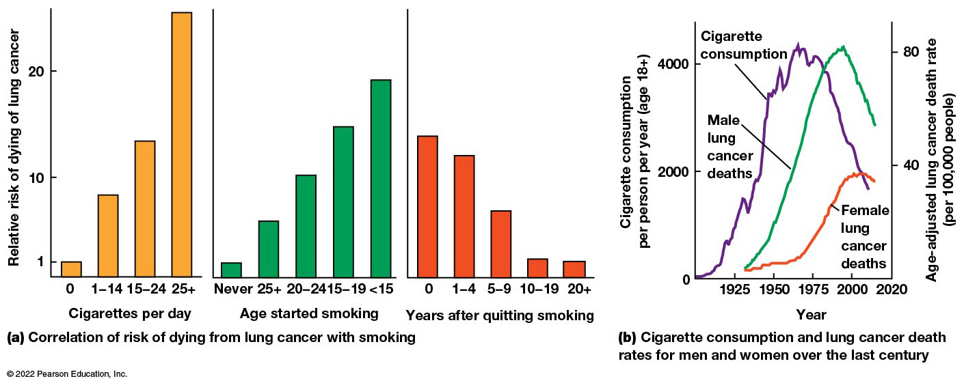
Cigarette Smoking and Lung Cancer
Figure 26.7 Cigarette Smoking and Lung Cancer.
Notes:
Long Description:
The details of the graphs are as below:
Line graph:
A multi-line graph shows years on the X axis from 1925 to 2020, in increments of 25 years. The Y axis shows cigarette consumption per person per year of age more than 18 from 0 to 4000, in increments of 2000.
The approximate data points are as below for cigarette consumption per person per year of 18 plus age:
Cigarette consumption: (1925, 750); (1950, 2000); (1975, 4000); (2000, 2500);
Male lung cancer deaths: (1925, 0); (1950, 1000); (1975, 3000); (2000, 4000).
Female lung cancer deaths: (1925, 0); (1950, 50); (1975, 500); (2000, 2000).
The approximate data points are as below for age adjusted lung cancer death rate per 1,00,000 people:
Cigarette consumption: (1925, 15); (1950, 40); (1975, 80), (2000, 40).
Male lung cancer deaths: (1925, 0); (1950, 20); (1975, 45); (2000, 80).
Female lung cancer deaths: (1925, 0); (1950, 5); (1975, 15); (2000, 38).
Bar graphs:
The approximate data points are as below.
Cigarettes per day on X axis versus relative risk of dying of lung cancer on Y axis: (0, 1); (1 to 14 years, 9); (15 to 24 years, 14); (25 plus years, over 25). As cigarettes per day increases, risk increases.
Age started smoking on the X axis versus relative risk of dying of lung cancer on Y axis: (Never, 1); (25 plus, 5); (20 to 24, 10); (15 to 19, 15); (less than 15, 18). If smoking was started at a lesser age, risk increases.
Years after quitting smoking on the X axis versus relative risk of dying of lung cancer on Y axis: (0, 14); (1 to 4, 13); (5 to 9, 8); (10 to 19, 2); (20 plus, 2).

Slide 43
Errors in D N A Replication or Repair Explain Many Cancers
A major explanation for cancer lies in failures in D N A replication or repair.
These tumors show no correlation between a patient’s environment or lifestyle and the tumor.
The number of stem cell divisions and the lifetime incidence of cancer in those tissues is correlated.
There is an additive effect between increased innate mutations, mutagens (environmental agents that cause cancer), and conditions (like cell stress).

Slide 44
Inborn Errors Explain Some Cancers
Humans inherit 50–100 mutations from their parents at birth.
Most of these mutations do not occur in protein coding regions. Of those that do, only a few are in genes that promote cancer.
However, some hereditary mutations lead to higher incidence of cancer, including those that control cell proliferation or DNA repair.
Any new mutations act on this background.

Slide 45
Many Chemicals Can Cause Cancer, Often After Metabolic Activation in the Liver
The list of known and suspected carcinogens (cancer-causing agents) has grown to include hundreds of different chemicals.
Many carcinogens share a need for metabolic activation before they can cause cancer.
In the liver, 2-naphthylamine is metabolized into other chemicals that actually cause cancer.

Slide 46
Precarcinogens
Substances that must be metabolically activated before causing cancer are called precarcinogens.
Most precarcinogens are activated in the liver by members of the cytochrome P450 enzyme family.
These catalyze the oxidation of foreign chemicals to make them less toxic and easier to eliminate from the body.
When oxidation reactions convert foreign chemicals into carcinogens, it is called carcinogen activation.

Slide 47
D N A Mutations Triggered by Chemical Carcinogens Lead to Cancer
Bruce Ames developed a simple laboratory test for measuring a chemical’s mutagenicity.
The Ames test uses bacteria because they grow quickly in large numbers.
The strain used cannot synthesize histidine.

Slide 48
D N A Damage
Carcinogens modify D N A in several ways:
Generating crosslinks between two strands of the double helix
Creating chemical links between adjacent bases
Hydroxylating or removing individual bases
Causing breaks in one or both strands

Slide 49
D N A Mutations and Cancer
The polycyclic aromatic hydrocarbons found in cigarette smoke preferentially bind to regions of the p53 gene.
Mutations in the p53 gene play a key role in many kinds of cancer.

Slide 50
Ionizing and Ultraviolet Radiation Also Cause D N A Mutations That Lead to Cancer
X-rays create D N A mutations and cause cancer in direct proportion to the dose administered.
A luminescent paint containing radium, used for painting watch dials, was found to trigger bone cancer in the workers who used the paint.
X-rays and related types of radiation are called ionizing radiation because they remove electrons from molecules making them highly reactive ions that generate D N A damage.

Slide 51
Ultraviolet Radiation
Ultraviolet radiation (U V) also causes cancer by damaging D N A .
U V radiation is absorbed mainly by the skin, where it triggers pyrimidine dimer formation: formation of covalent bonds between adjacent pyrimidine bases in D N A .
If this damage is not repaired, it can cause incorrect nucleotides to be incorporated during replication of D N A .

Slide 52
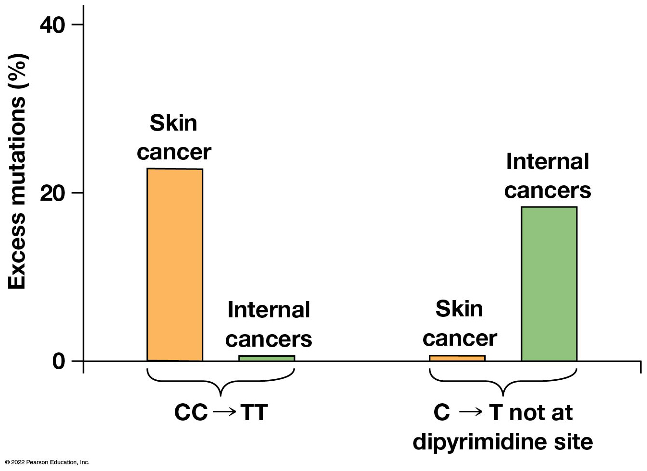
Incidence of Two Types of p53 Mutations in Skin Cancer and Internal Cancers
Figure 26.9 Incidence of Two Types of p53 Mutations in Skin Cancer and Internal Cancers.
Notes:
The X axis shows the frequency of C C to T T mutation and C to T not at dipyrimidine site. The Y axis shows excess mutations percentage from 0 to 40, in increments of 20.
The approximate data points are as below:
C C to T T mutation
Skin cancer: 22 percent; Internal cancers: Negligible.
C to T not at dipyrimidine site
Skin cancer: Negligible; Internal cancers: 19 percent.

Slide 53
Viruses and Other Infectious Agents Trigger the Development of Some Cancers
In 1911, Peyton Rous performed experiment on chickens that had cancers of connective tissues (sarcomas).
He showed that cancer can be caused by a virus.
This was the first time anyone had detected an oncogenic virus, one that causes cancer.

Slide 54
Viruses and Cancer
It is now known that dozens of viruses can cause cancer in animals.
A few are linked to human cancers.
Burkitt lymphoma, which was identified in the late 1950s, was shown to be associated with Epstein-Barr virus (EBV).

Slide 55
EBV and Cancer: Evidence
EBV D N A and proteins are often found in tumor cells of patients with Burkitt lymphoma, but not in their normal cells.
Adding E B V to human lymphocytes in culture causes the cells to acquire properties of cancers.
Injecting E B V into monkeys causes lymphomas.

Slide 56
Other Viruses Linked to Human Cancers
Hepatitis B and hepatitis C viruses can trigger some liver cancers.
Human T-cell lymphotropic virus-I (HTLV-I) causes adult T-cell lymphoma.
Human papillomavirus (H P V ) is associated with uterine cervical cancer.

Slide 57
Other Infectious Agents
Helicobacter pylori (H. pylori)—a common cause of stomach ulcers—is linked to stomach cancer.
Flatworm infections are linked to a small number of bladder and bile duct cancers.

Slide 58
Cancer Prevention
Knowing the infectious agents associated with cancer allows for prevention strategies.
Antibiotics against H. pylori or vaccinations against viruses can prevent cancers.

Slide 59
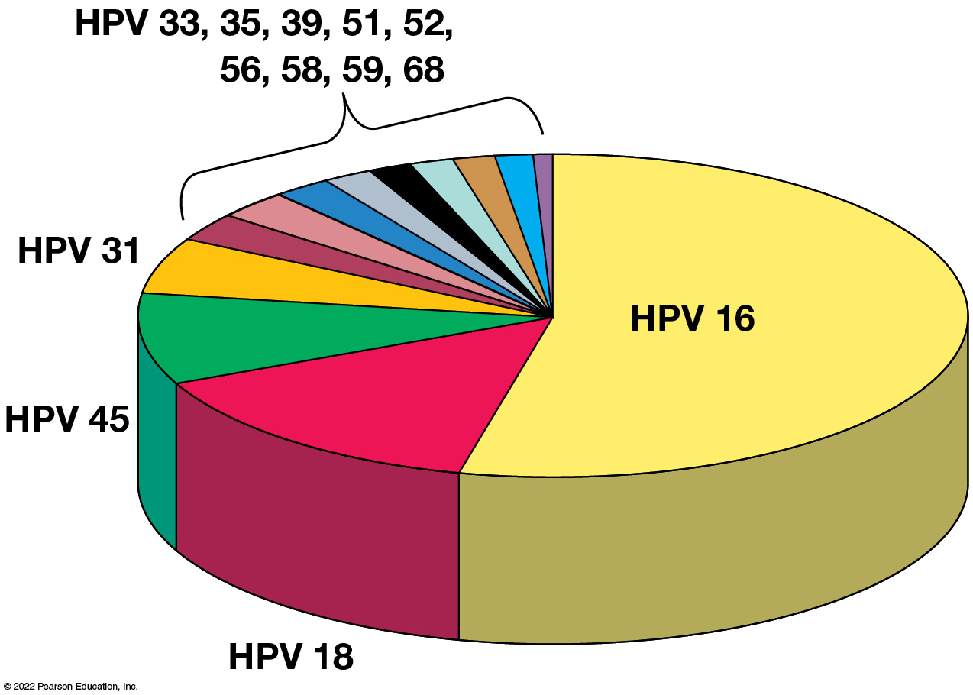
Prevalence of Various Subtypes of HPV in Cervical Cancers
Figure 26.10 Prevalence of Various Subtypes of HPV in Cervical Cancers.
Notes:
Long Description:
The share of HPV subtype from high to low are in the below order:
HPV 16
HPV 18
HPV 45
HPV 31
HPV 33, 35, 39, 51, 52, 56, 58, 59, 68

Slide 60
26.4 Oncogenes and Tumor Suppressor Genes
D N A mutations involved in cancer generally affect genes that control cell proliferation and survival.
The two main classes of affected genes are oncogenes and tumor suppressor genes.

Slide 61
Oncogenes Are Genes Whose Products Can Trigger the Development of Cancer
An oncogene is one whose presence can trigger the development of cancer.
Some are introduced to the cell by cancer-causing viruses.
Others arise from mutation of normal cellular genes.
Oncogenes encode proteins that stimulate excessive cell proliferation and/or promote cell survival by inhibiting apoptosis.

Slide 62
The First Identified Oncogene
The first oncogene discovered was in the Rous sarcoma virus.
Mutant viruses with defects in src (one of just four genes in the virus) can infect cells and reproduce normally but cannot trigger cancer.
Thus, a functional copy of src must be present for cancer to arise.

Slide 63
Oncogenes from Cancers Not Caused by Viruses
D N A from isolated human bladder cancer cells was introduced to cultured mouse cells. These cells were injected back into mice and the animals developed cancer.
D N A was isolated and cloned from the mouse cancer cells.
A mutant form of the human gene called R A S was associated with the ability of the cells to promote cancer.

Slide 64
Oncogenes
R A S was just the first of over 200 human oncogenes identified.
A single oncogene is generally not sufficient to cause cancer.
Multiple mutations are usually required to convert a normal cell into a cancer cell.

Slide 65
Proto-oncogenes Are Converted into Oncogenes by Several Distinct Mechanisms
Oncogenes arise from mutation of normal cellular genes called proto-oncogenes.
These are normal genes that contribute to regulation of cell growth and survival.
If and when the structure of this gene is altered, the mutated form can cause cancer.
Proto-oncogenes can be converted into oncogenes through several distinct mechanisms.

Slide 66
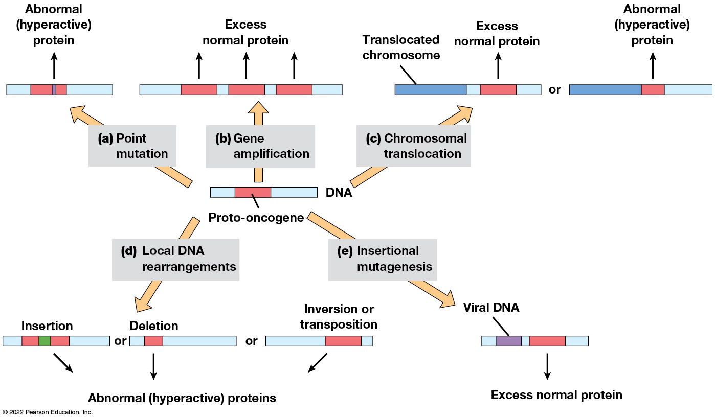
Five Mechanisms for Converting Proto-oncogenes into Oncogenes
Figure 26.11 Five Mechanisms for Converting Proto-oncogenes into Oncogenes.
Notes:
Long Description:
The DNA consists of proto-oncogene. The results of the five mechanisms are as below:
Point mutation: Abnormal hyperactive protein indicated by a small purple strip within the proto-oncogene.
Gene amplification: Excess normal protein is synthesized.
Chromosomal translocation: Translocated chromosome on one side and excess normal protein is synthesized too. The other possibility is translocated chromosome with abnormal hyperactive protein.
Local DNA arrangements: Insertion or deletion or inversion or transposition of abnormal hyperactive proteins.
Insertional mutagenesis: Viral DNA stimulating excess normal protein.

Slide 67
Point Mutation
A point mutation is a single nucleotide substitution that causes a single amino acid change in the protein product of the gene.
The most frequently encountered oncogenes of this type are R A S oncogenes.
The mutations cause the Ras pathway to be continually activated, leading to excessive cell proliferation.

Slide 68
Gene Amplification
Gene amplification increases the number of copies of a proto-oncogene.
The protein encoded by the proto-oncogene is normal. It is just produced in excessive amounts.
About 25% of human breast and ovarian cancers have amplified copies of the ERBB2 gene.
The extra copies of this growth factor receptor cause excessive cell proliferation.

Slide 69
Chromosomal Translocation
During chromosomal translocation, part of one chromosome is physically removed and joined to another chromosome.
In Burkitt lymphoma, a proto-oncogene called M Y C is moved from chromosome 8. It becomes situated next to a highly active region of chromosome 14, causing M Y C to be highly transcribed.
This is an example of chromosomal translocation causing a gene to be overexpressed; it does not change the gene (or protein) structure.

Slide 70
Chromosomal Translocation: The Philadelphia Chromosome
The Philadelphia chromosome is a version of chromosome 22 that has undergone a translocation with chromosome 9.
The translocation creates an oncogene called B C R - A B L, which produces a fusion protein of the B C R and A B L genes. This is an example of a disrupted gene structure which causes an abnormal protein.
It is commonly associated with chronic myelogenous leukemia.

Slide 71
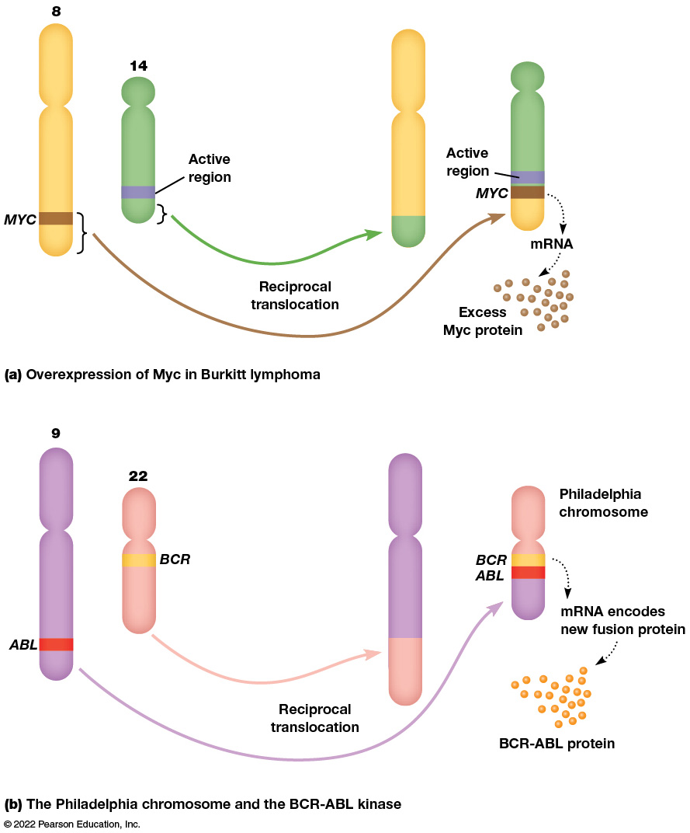
Chromosome Translocations and Cancer
Figure 26.12 Chromosome Translocations and Cancer.
Notes:
Long Description:
Overexpression of Myc in Burkitt lymphoma: Chromosome number 8 with MYC segment and chromosome number 14 with an active region are labeled in the illustration. The reciprocal translocation process places normal MYC and other portion from chromosome number 8 to an adjacent location to the active region of chromosome number 14. This consists of mRNA that causes excess Myc protein. Also, the removed portion of chromosome 8 is compensated with portion from chromosome number 14.
The Philadelphia chromosome and the BCR-ABL kinase: Abnormally long chromosome number 9 consists of an A B L segment. Abnormally short chromosome number 22 consists of a B C R segment. By reciprocal translocation, the A B L segment along with some other portion from chromosome number 9 is placed adjacent to B C R of chromosome number 22. This mRNA encodes new fusion protein producing BCR-ABL protein. The resultant fusion chromosome is termed as Philadelphia chromosome. Also, the removed portion of chromosome 9 is compensated with portion from chromosome number 22.

Slide 72
Local D N A Rearrangements
In local rearrangements, proto-oncogenes are altered by deletions, insertions, inversions, or transposition.
A simple inversion involving the NTRK1 and TPM3 genes results in a fusion gene called the TRK oncogene.
This fusion protein forms a permanent dimer, and the kinase is constantly activated.

Slide 73
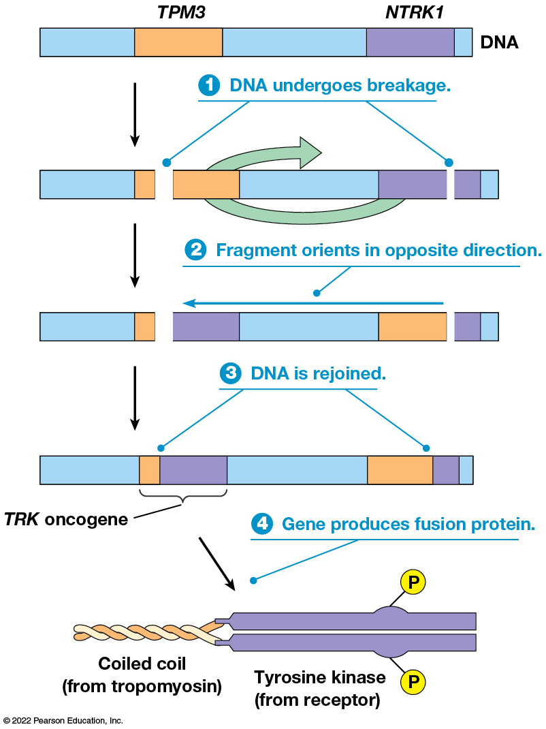
Origin of the T R K Oncogene
Figure 26.13 Origin of the T R K Oncogene.
Notes:
Long Description:
The steps are as below:
DNA undergoes breakage at T P M 3 and N T R K 1.
Fragment orients in opposite direction.
DNA is rejoined where a segment of T P M 3 is joined with N T R K 1 forming T R K oncogene.
Gene produces fusion protein. A coiled coil from tropomyosin and tyrosine kinase from receptor are shown. Small protrusions of P are shown on the tyrosine kinase.

Slide 74
Insertional Mutagenesis
Retroviruses can sometime cause cancer even if they have no oncogene of their own.
They do this by integrating their genes near a proto-oncogene on the host chromosome, leading to overexpression of the gene.
This insertional mutagenesis is frequent in animal cancers but rare in humans.

Slide 75
Most Oncogenes Encode Components of Growth-Signaling Pathways
Oncogenes fall into six categories:
Growth factors
Receptors
Plasma membrane GTP-binding proteins
Nonreceptor protein kinases
Transcription factors
Cell cycle or apoptosis regulators

Slide 76
A Few Examples of Oncogenes Grouped by Protein Function (1 of 3)
Table 26.1 A Few Examples of Oncogenes Grouped by Protein Function
Oncogene Name | Protein Produced | Oncogene Origin | Common Cancer Type*
Growth factors
v-sis | PDGF | Viral | Sarcomas (monkeys)
COL1A1-PDGFB | PDGF | Translocation | Fibrosarcoma
Receptors
v-erb-b | Epidermal growth factor receptor | Viral | Leukemia (chickens)
TRK | Nerve growth factor receptor | DNA rearrangement | Thyroid
ERBB2 | Epidermal growth factor receptor 2 | Amplification | Breast
v-mpl | Thrombopoietin receptor | Viral | Leukemia (mice)
Notes:
Long Description:
The data in the table is as follows:
Growth factors:
Oncognene name: v-sis; protein produced: PDGF; Oncognene origin: viral; common cancer type: sarcomas (monkeys)
Oncognene name: COL1A1-PDGFB; protein produced: PDGF; Oncognene origin: translocation; common cancer type: fibrosarcoma
Receptors:
Oncognene name: v-erb-b; protein produced: epidermal growth factor receptor; Oncognene origin: viral; common cancer type: leukemia (chickens)
Oncognene name: TRK; protein produced: nerve growth factor receptor; Oncognene origin: DNA rearrangement; common cancer type: thyroid
Oncognene name: ERBB2; protein produced: epidermal growth factor receptor 2; Oncognene origin: amplification; common cancer type: breast
Oncognene name: v-mpl; protein produced: thrombopoietin receptor 2; Oncognene origin: viral; common cancer type: leukemia (mice)

Slide 77
A Few Examples of Oncogenes Grouped by Protein Function (2 of 3)
Plasma membrane GTP-binding proteins
KRAS | Ras | Point mutation | Pancreas, colon, lung, others
HRAS | Ras | Point mutation | Bladder
NRAS | Ras | Point mutation | Leukemias
Nonreceptor protein kinases
BRAF | Raf kinase | Point mutation | Melanoma
v-src | Src kinase | Viral | Sarcomas (chickens)
SRC | Src kinase | DNA rearrangement | Colon
TEL-JAK2 | Jak kinase | Translocation | Leukemias
BCR-ABL | Abl kinase | Translocation | Chronic myelogenous leukemia

Slide 78
A Few Examples of Oncogenes Grouped by Protein Function (3 of 3)
Transcription factors
MYC | Myc | Translocation | Burkitt lymphoma
MYCL | Myc | Amplification | Small cell lung cancer
c-myc | Myc | Insertional mutagenesis | Leukemia (chickens)
v-jun | Jun | Viral | Sarcomas (chickens)
v-fos | Fos | Viral | Bone (mice)
Cell cycle or apoptosis regulators
CYCD1 | Cyclin | Amplification, translocation | Breast, lymphoma
CDK4 | Cdk | Amplification | Sarcomas, glioblastoma
BCL2 | Bcl-2 | Translocation | Non-Hodgkins lymphoma
MDM2 | Mdm2 | Amplification | Sarcomas, lung, breast, others
*Cancers are in humans unless otherwise specified. Only the most frequent cancer types are listed.

Slide 79
Growth Factors
Cells do not normally divide unless stimulated by an appropriate growth factor.
Monkey cells infected with the simian sarcoma virus produce a mutant form of platelet-derived growth factor (P D G F ), which continually stimulates the cell’s proliferation.
Some human sarcomas contain a P D G F -related oncogene caused by a chromosomal translocation that creates a gene that is part P D G F and part collagen.

Slide 80
Receptors
Many receptors exhibit tyrosine kinase activity that is activated when a growth factor binds the receptor.
Oncogenes sometimes encode mutant forms of the receptors that are permanently activated.
The v-erb-b oncogene produces an altered form of the epidermal growth factor receptor that is constitutively active (that is, active with or without binding of a growth factor).

Slide 81
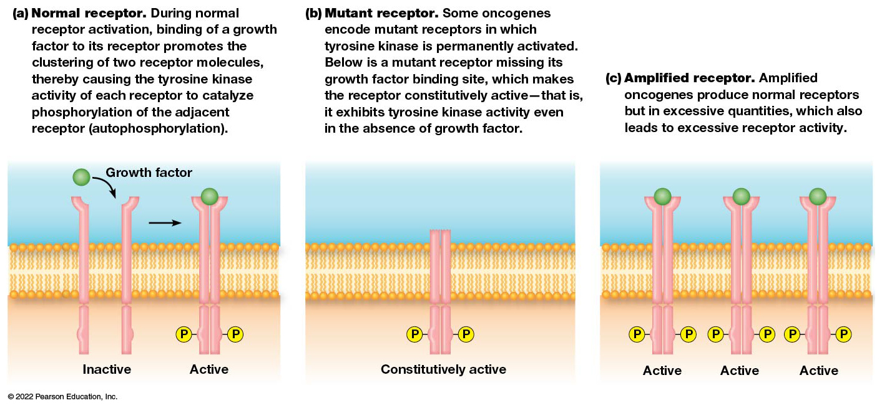
Receptor Tyrosine Kinases in Normal and Cancer Cells
Figure 26.14 Receptor Tyrosine Kinases in Normal and Cancer Cells.
Notes:
Long Description:
The details are as below:
Normal receptor. During normal receptor activation, binding of a growth factor to its receptor promotes the clustering of two receptor molecules, thereby causing the tyrosine kinase activity of each receptor to catalyse phosphorylation of the adjacent receptor (autophosphorylation). Binding of growth factor to a disjoint inactive receptor makes the receptor to cluster together to make it active with protrusions labeled as P.
Mutant receptor. Some oncogenes encode mutant receptors whose tyrosine kinase is permanently activated. Below is a mutant receptor missing its growth factor binding site, which makes the receptor constitutively active, that is, it exhibits tyrosine kinase activity even in the absence of growth factor. The receptor is labeled as constitutively active with protrusions as P.
Amplified receptor. Amplified oncogenes produce normal receptors but in excessive quantities, which also leads to excessive receptor activity. There are multiple active receptors with P as protrusions and growth factor attached to it.

Slide 82
Other Oncogenic Receptors
Some oncogenes produce normal receptors but in excessive quantities, such as E R B B 2 .
Some signaling pathways use receptors that stimulate activity of independent tyrosine kinases.
An oncogene, v-mpl, from myeloproliferative leukemia virus, encodes a mutant form of thrombopoietin that uses the Jak-STAT pathway to stimulate proliferation of platelets.

Slide 83
Plasma Membrane G T P-Binding Proteins
In many growth-signaling pathways, growth factor binding of a receptor leads to Ras activation.
Oncogenes encoding mutant Ras proteins are a common genetic abnormality in human cancers.
These hyperactive Ras proteins retain bound G T P instead of hydrolyzing it to G D P.
Keeping the protein in a permanently activated state, continuously sending signal that keeps the Ras pathway activated.

Slide 84
Nonreceptor Protein Kinases
Protein phosphorylation reactions are often used to transmit signals within the cell via nonreceptor protein kinases.
Several oncogenes encode proteins involved in the cascade of phosphorylation reactions that follow Ras activation.
Oncogenes have been found encoding other nonreceptor protein kinases in different signaling cascades, including Src, Jak, and Abl.

Slide 85
Transcription Factors
Some growth-signaling pathways trigger changes in transcription factors, thus altering gene expression.
Oncogenes can produce mutant or excessive transcription factors in many types of cancer.
A common oncogene encodes the Myc transcription factor.
Burkitt lymphoma is one of several human cancers in which the Myc protein is overproduced.

Slide 86
Cell Cycle and Apoptosis Regulators
In the final step of growth-signaling pathways, transcription factors activate genes with products that control proliferation and survival.
The activated genes include those that encode cyclins and cyclin-dependent kinases (Cdks).
Several human oncogenes encode proteins of this type.

Slide 87
Examples from Human Cancers
The cyclin-dependent kinase gene, CDK4, is amplified in some sarcomas.
Cyclin, CYCD1, is commonly amplified in breast cancers.
It is altered by translocation in some lymphomas.

Slide 88
Oncogenes with Other Functions
Some oncogenes inhibit apoptosis rather than stimulating cell division.
The protein Bcl-2 inhibits apoptosis; translocations involving this gene are seen in some lymphomas.
The MDM2 gene can cause a failure of apoptosis when the gene is amplified or abnormally expressed.

Slide 89
Tumor Suppressor Genes Are Genes Whose Loss or Inactivation Can Lead to Cancer
The loss or inactivation of tumor suppressor genes can lead to cancer.
The normal function of such genes is to restrain cell proliferation.
A few dozen genes in human cells exhibit the properties of tumor suppressors.

Slide 90
Cell Fusion Experiments to Indicate Cells Have Tumor Suppressor Genes
In the 1960s, normal cells were experimentally fused with cancer cells.
The hybrid cells usually behaved normally and did not form tumors.
However, if grown in culture for long periods of time, they revert to malignant, uncontrolled behavior of the original cancer cells.

Slide 91
Tumor Suppression and Oncogenes
In the hybrid cells, tumor suppression is observed even when the original cells possessed an oncogene, such as R A S .
The ability to form tumors does not appear until the hybrid cell loses a chromosome containing a critical tumor-suppressor gene.
Tumor suppressor genes can be identified in families with heritable forms of cancer; they have increased susceptibility to cancer.

Slide 92
The Two-Hit Hypothesis
Increased cancer susceptibility is usually an inherited defect in a tumor suppressor gene.
Two successive mutations in the same gene would be required to produce a loss of function in a tumor suppressor gene.
If people inherit a mutation in one copy of the gene, there is a greater chance of sustaining a second mutation in the gene: the two-hit hypothesis.

Slide 93
Loss of Heterozygosity
An inactivating mutation in the second copy of a tumor suppressor gene can lead to cancer.
When all or part of a chromosome containing the normal allele of the gene is deleted, this is called loss of heterozygosity (L O H ).
L O H can be confirmed by looking for deletion of microsatellite or short tandem repeat (S T R ) markers on the chromosome.

Slide 94
The RB Tumor Suppressor Gene Was Discovered by Studying Families with Hereditary Retinoblastoma
Hereditary retinoblastoma is a rare inherited eye cancer that develops in young children.

Slide 95
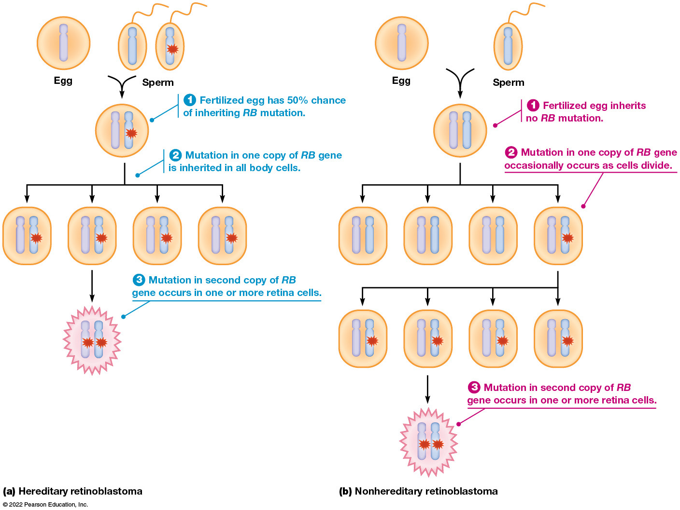
Behavior of Tumor Suppressor Genes in Hereditary and Nonhereditary Cancers
Figure 26.15 Behavior of Tumor Suppressor Genes in Hereditary and Nonhereditary Cancers.
Notes:
Long Description:
Hereditary retinoblastoma: The stages re as below.
Fusion of an egg and one of the sperms with R B mutant gene. Fertilized egg has 50 percent chance of inheriting R B mutation.
The cell division creates four cells.
Mutation in one copy of RB gene is inherited in all body cells.
Mutation in second copy of RB gene occurs in one or more retina cells
Nonhereditary retinoblastoma
Fusion of an egg and a sperm without any R B mutant gene. Fertilized egg inherits no R B mutation.
The cell division creates four cells. Mutation in one copy of R B gene occasionally occurs in one of the four cells as cells divide.
When the cell with the mutated gene further divides, it creates four more cells with R B mutated gene.
Mutation in second copy of R B gene occurs in one or more retina cells.

Slide 96
Retinoblastoma
Children with retinoblastoma inherit a deletion of part of chromosome 13.
Individual retinal cells may occasionally acquire a deletion or mutation in the same region of chromosome 13.
Cancers arise from such cells.
The RB gene was identified as responsible for this.

Slide 97
R b
The R B gene product is required to prevent cells from passing through the G1 restriction point without an appropriate signal from a growth factor.
Mutations in the gene disrupt the normal controls on cell proliferation; this effect is also seen in other types of cancers.
Mutations in R B are detected in nonhereditary retinoblastomas and other nonhereditary cancers.

Slide 98
R b and H P V
The R b protein is a target for certain cancer viruses.
Human papillomavirus (H P V) contains an oncogene that produces the E7 protein.
E7 normally binds Rb in infected cells to prevent it from halting cell proliferation.
So, cancer is triggered by loss of Rb function or via inhibition of its function through viral proteins.

Slide 99
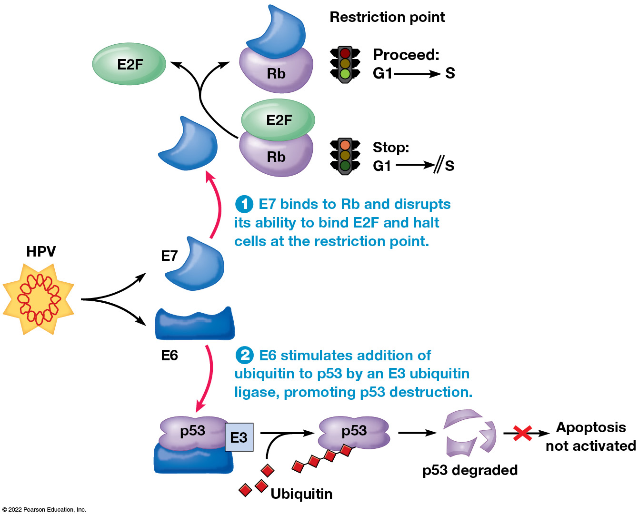
Oncogenes of the Human Papillomavirus (H P V)
Figure 26.16 Oncogenes of the Human Papillomavirus (H P V).
Notes:
Long Description:
H P V has two proteins, E 6 and E 7.
Reactions with E 7: E 7 binds to R b and disrupts its ability to bind E 2 F and halt cells at the restriction point.
Reactions with E 6: E 6 stimulates addition of ubiquitin to p53 by an E 3 ubiquitin ligase, promoting p53 destruction. Apoptosis is not activated.

Slide 100
The p53 Tumor Suppressor Gene Is the Most Frequently Mutated Gene in Human Cancers
The p53 gene is mutated in almost half of cancers.
D N A damage stimulates the p53 pathway, which triggers cell cycle arrest and apoptosis.
p53 gene disruption causes failure of apoptosis that contributes to cancer development by allowing survival and reproduction of cells with D N A damage.

Slide 101
p53 and Inherited Cancers
Individuals who inherited a defective copy of the p53 gene exhibit an increased cancer risk.
In Li-Fraumeni syndrome, various types of cancer arise by early adulthood due to mutations that inactivate the second copy of the gene.
p53 is targeted by cancer viruses; HPV has an oncogene that produces E6 protein, which targets p53 protein for destruction.

Slide 102
The APC Tumor Suppressor Gene Encodes a Protein That Inhibits the Wnt Signaling Pathway
Mutations in the APC gene are associated with familial adenomatous polyposis.
Individuals with a defective copy of this are susceptible to developing thousands of polyps (benign tumors) in the colon if the second copy of the gene is mutated.
This leads to an increased risk of colon cancer.

Slide 103
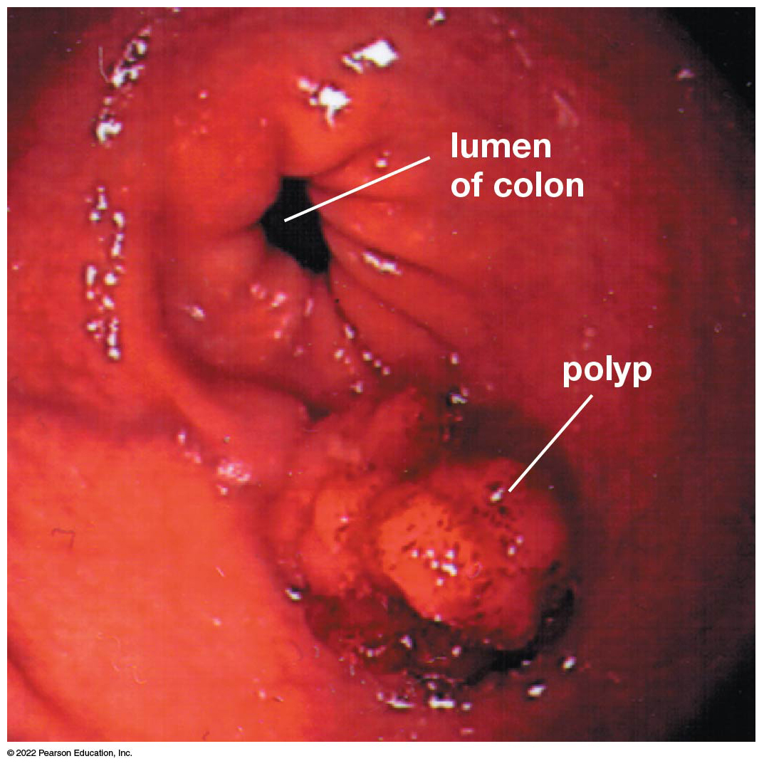
A Colon Polyp
Figure 26.17 A Colon Polyp.

Slide 104
Inactivation of Some Tumor Suppressor Genes Leads to Genetic Instability
Cancers almost always exhibit mutations in multiple genes.
Mutation rates in cancer cells are hundreds or thousands of times higher than normal.
This state, called genetic instability, arises in several ways.

Slide 105
Genetic Instability and Disruptions in D N A Repair (1 of 2)
Inherited defects in genes needed for mismatch repair are responsible for hereditary nonpolyposis colon cancer (H N P C C ).
Xeroderma pigmentosum is caused by defects in genes needed for excision repair.

Slide 106
Genetic Instability and Disruptions in D N A Repair (2 of 2)
Most hereditary forms of breast (and ovarian) cancers are related to mutations of either BRCA1 or BRCA2.
These two genes encode proteins involved in repair of double-strand breaks.

Slide 107
Genetic Instability and p53
The p53 pathway is defective in most cancer cells.
This defect removes a protective mechanism that prevents cells with damaged D N A from proliferating.
The result of this defect is wholesale damage to D N A, including large-scale chromosome rearrangements.

Slide 108
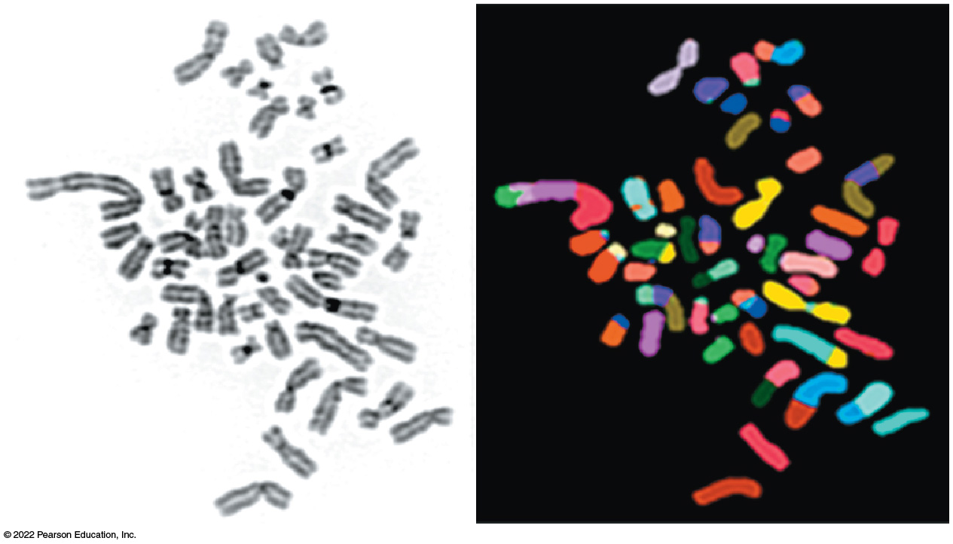
Chromosome Instability in a Cancer Cell
Figure 26.19 Chromosomal Instability in a Cancer Cell.
Notes:
Long Description:
The uncolored micrograph shows fragmented and rearranged pieces of chromosomes of different sizes. The colored micrograph shows the same condition where there are single chromosomes represented in one color. Other chromosomes are represented in two or more colors each.

Slide 109
Genetic Instability and Defects in Mitosis (1 of 2)
Disruptions in chromosome sorting during mitosis can result in broken chromosomes.
The result is aneuploidy, an abnormal number of chromosomes.
One reason for the improper sorting of chromosomes is the presence of extra centrosomes.

Slide 110
Genetic Instability and Defects in Mitosis (2 of 2)
Cancer cells may also exhibit defects in proteins involved in attaching chromosomes to the spindle.
Also, the mitotic assembly checkpoint may not operate correctly.
In both cases, aneuploidy may result.

Slide 111
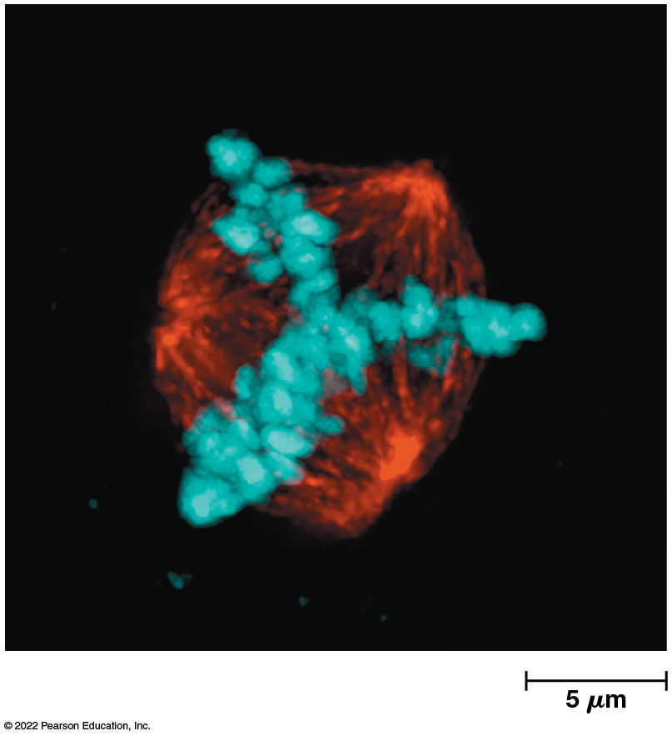
Abnormal Mitosis in a Cancer Cell
Figure 26.20 Abnormal Mitosis in a Cancer Cell.
Notes:
Long Description:
The tubulin in the cell shows abnormal spindle with three poles. The measurement is marked as 5 micrometers.

Slide 112
Categories of Tumor Suppressor Genes
Genes like RB, p53, and A P C are called gatekeeper genes.
Their loss opens the gates to excessive cell proliferation.
Genes involved in D N A repair and chromosome sorting are called caretaker genes because they maintain genetic stability.

Slide 113
Examples of Tumor Suppressor Genes
Table 26.2 Examples of Tumor Suppressor Genes
Gene | Pathway Affected
Gatekeeper Genes
A P C | Wnt signaling
CDKN2A | Rb and p53 signaling
P T E N | P I 3-kinase–Akt signaling
R B | Restriction point control
S M A D4 | T G F β-Smad signaling
T G F β receptor | T G F β-Smad signaling
p53 | D N A damage response
Caretaker Genes
BRCA1, BRCA2 | D N A double-strand break repair
MSH2, MSH3, MSH4, MSH5, MSH6, PMS1, PMS2, MLH1 | DNA mismatch repair
XPA, XPB, XPC, XPD, XPE, XPF, XPG | DNA excision repair
XPV (POLη) | DNA translesion synthesis

Slide 114
Cancers Develop by the Stepwise Accumulation of Mutations Involving Oncogenes and Tumor Suppressor Genes
For a given type of cancer, there are typically mutations in 50−75 different protein-coding genes.
A small number are mutated frequently in the same types of cancers of many different patients, whereas the rest are infrequently mutated.
The commonly mutated genes affect about a dozen different pathways.

Slide 115
Common Mutations in Cancer
Common mutations involve inactivation of tumor suppressor genes and the conversion of proto-oncogenes to oncogenes.
In colon cancer, the most common pattern is presence of a K R A S oncogene (member of the R A S gene family).
This is accompanied by mutations in the A P C, SMAD4, and p53 genes.

Slide 116
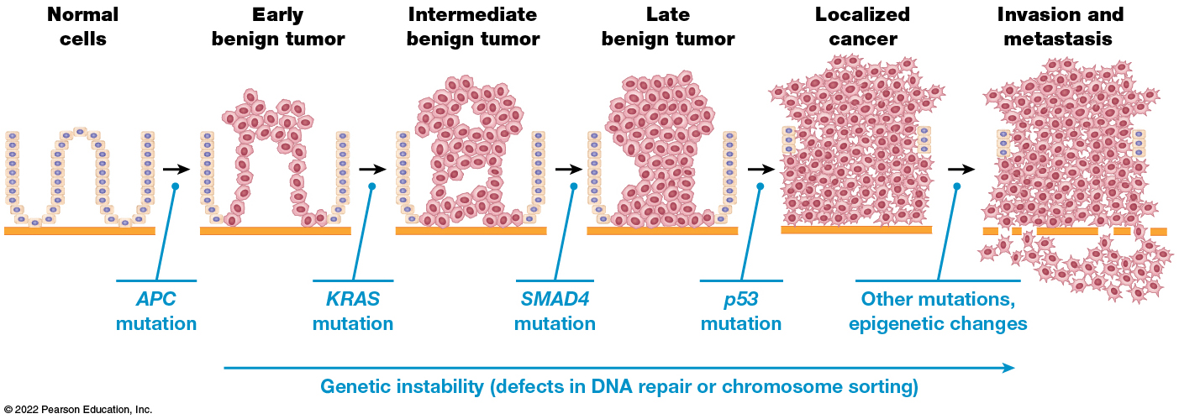
Stepwise Model for the Development of Colon Cancer
Figure 26.21 Stepwise Model for the Development of Colon Cancer.
Notes:
Long Description:
The progression of the cancerous cells shows genetic instability, defects in DNA repair or chromosomal sorting. The progression is as below:
Normal cells to early benign tumor by the process of A P C mutation.
Early benign tumor to intermediate benign tumor by K R A S mutation.
Intermediate benign tumor to late benign tumor by S M A D 4 mutation.
Late benign tumor to localized cancer by p 53 mutation.
Localized cancer to invasion and metastasis by other mutations and epigenetic changes.
Each stage shows more abnormal and increasing number of mutant cells than the previous stage.

Slide 117
Identifying Mutations Associated with Cancer
Genome-wide association studies (G W A S) involve sequencing the entire genomes of many cancers.
The aim is to correlate specific mutations common to particular diseases, including cancer.
One coordinating effort to create a comprehensive analysis of mutant genomes in common types of cancers is the Cancer Genome Atlas managed by the U.S. National Institutes of Health (N I H).

Slide 118
Epigenetic Changes in Gene Expression Influence the Properties of Cancer Cells
Epigenetic changes are alterations in gene expression that do not involve sequence changes.
D N A methylation at –CG– sites near gene promoters lead to epigenetic silencing of genes.
Tumor suppressor genes of cancer cells are inactivated by D N A methylation, an initiating event on the road to cancer.

Slide 119
MicroRNAs
MicroRNAs bind to and silence translation of mRNAs. Cancer cells can produce either too many or too few microRNAs.
Amplification of miR-17-92 results in inhibiting P T E N. This allows the PI 3-kinase-Akt pathway to be continually activated, leading to enhanced cell proliferation.
Deletion of miR-15a/miR-16-1 leads to excessive production of Bcl-2, which interferes with the ability to undergo apoptosis.

Slide 120
Summing Up: Carcinogenesis and the Hallmarks of Cancer
Carcinogenesis is the multistep process that converts normal cells into cancer cells.
Cancer cells develop a group of six traits, called the hallmarks of cancer.
These traits are common to all forms of cancer, but each trait can be acquired differently.

Slide 121
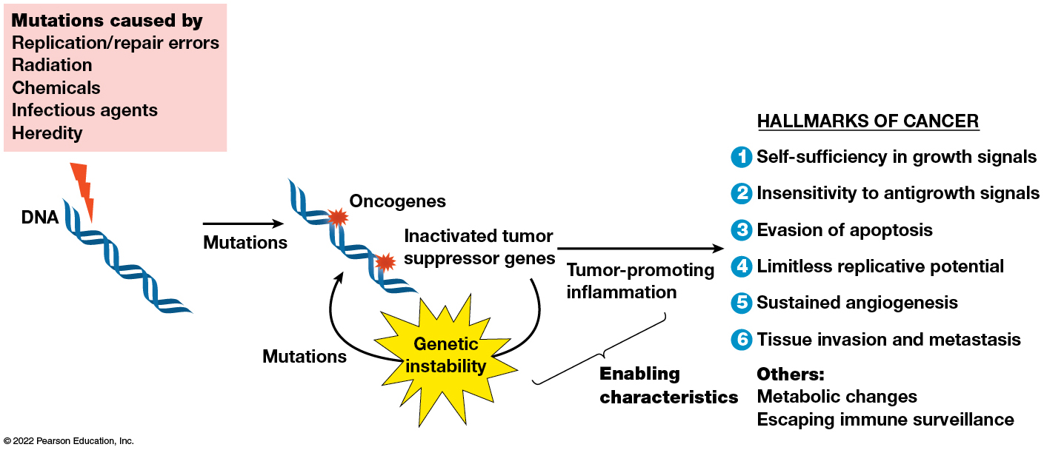
Overview of Carcinogenesis
Figure 26.22 Overview of Carcinogenesis.
Notes:
Long Description:
The mutations are caused by:
Replication or repair errors
Radiation
Chemicals
Infectious agents
Heredity
The carcinogenesis process is as below:
Mutations in genes causes oncogenes.
Inactivated tumor suppressor genes cause genetic instability and hence mutations.
This leads to tumor-promoting inflammation.
There are six characteristic hallmarks of cancer.
Self-sufficiency in growth signals
Insensitivity to antigrowth signals
Evasion of apoptosis
Limitless replicative potential
Sustained angiogenesis
Tissue invasion and metastasis
Others: Metabolic changes, escaping immune surveillance.

Slide 122
1. Self-Sufficiency in Growth Signals
Cells do not normally proliferate unless stimulated by a growth factor.
Cancer cells escape this requirement through action of oncogenes.
For example, about 25–30% of all human cancers have mutant Ras proteins that promote division independently of growth factors.

Slide 123
2. Insensitivity to Antigrowth Signals
Normal tissues are protected from excess proliferation by growth-inhibiting mechanisms.
Cancer cells evade such antigrowth signals.
Most inhibiting signals work through the Rb protein.
Mutation in the RB gene make the cells insensitive to any antigrowth signals that exert their effect through the Rb protein.

Slide 124
3. Evasion of Apoptosis
Cancer cells evade apoptosis, which normally destroys cells with genetic damage.
This is often brought about by mutations in the p53 gene.
The p53 pathway is also disrupted by mutations affecting the MDMD2 gene or the BCL2 gene.

Slide 125
4. Limitless Replicative Potential
Telomere maintenance is usually accomplished by activating the gene encoding telomerase.
Cancer cells maintain telomere length above a critical threshold.
Thus, they are able to divide indefinitely.

Slide 126
5. Sustained Angiogenesis
A blood supply is needed for cancer cells to grow beyond a few millimeters.
Cancer cells commonly activate genes encoding angiogenesis stimulators.
They also inhibit genes encoding angiogenesis inhibitors.

Slide 127
6. Tissue Invasion and Metastasis
Three properties of cancer cells play a crucial role in invasion and metastasis:
Decreased cell-cell adhesion
Increased motility
Production of proteases that degrade the basal lamina and extracellular matrix

Slide 128
Other Hallmarks
Cancer cells often use aerobic glycolysis, a process that bypasses aerobic metabolism even when oxygen is present.
Cancer cells have mechanisms to evade the immune system.

Slide 129
Enabling Characteristics: Genetic Instability and Tumor-Promoting Inflammation
Aggressive cancers have two enabling characteristics: genetic instability and tumor-promoting inflammation.
Genetic instability permits cells to accumulate mutations that lead to the hallmarks of cancer.
Tumors are infiltrated with immune system cells, possibly to attack the tumor. However, the inflammatory effect enhances tumor growth. This allows the tumor to acquire the hallmarks of cancer.

Slide 130
26.5 Diagnosis, Screening, and Treatment
The hope is that understanding of the molecular alterations in cancer cells will lead to improved strategies for diagnosis and treatment.

Slide 131
Cancer Is Diagnosed by Microscopic Molecular Examination of Tissue Specimens
A definitive cancer diagnosis requires a biopsy, surgical removal of a tiny tissue sample for microscopic examination.
Cancer cells usually display several features that together indicate the presence of cancer.

Slide 132
Features of Cancer Cells
Cancer cells often have
Large, irregularly shaped nuclei
Prominent nucleoli
High ratio of nuclear-to-cytoplasmic volume
Significant variations in cell size and shape
Loss of normal tissue organization

Slide 133
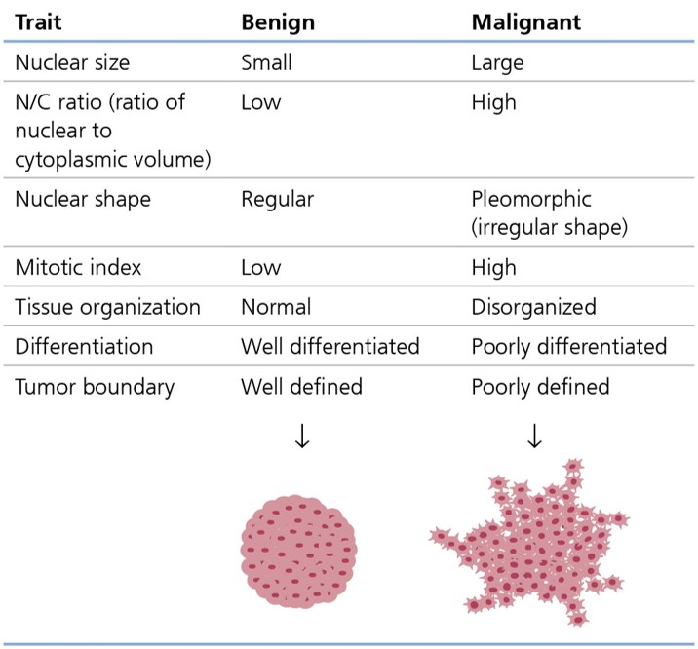
Some Differences in the Microscopic Traits of Benign and Malignant Tumors
Table 26.3 Some Differences in the Microscopic Traits of Benign and Malignant Tumors
Notes:
Long Description:
The difference in traits for the tumors are as follows:
Nuclear size: benign – small; malignant – large
N/C ratio (ratio of nuclear to cytoplasmic volume): benign – low; malignant – high
Nuclear shape: benign – regular; malignant – pleomorphic (irregular shape)
Mitotic index: benign – low; malignant – high
Tissue organization: benign – normal; malignant – disorganized
Differentiation: benign – well differentiated; malignant – poorly differentiated
Tumor boundary: benign – well defined; malignant – poorly defined
An illustration shows a well-defined benign tumor that is circular in shape and a poorly defined malignant tumor that has an irregular shape.

Slide 134
Tumor Grading (1 of 2)
A sufficient number of abnormal traits allow diagnosis of cancer, even in the absence of invasion and metastasis.
The severity of abnormal traits varies among cancers.
Tumor grading is the assignment of numbered grades to tumors based on microscopic appearance.

Slide 135
Tumor Grading (2 of 2)
Lower numbers are assigned to tumors whose cells show normal, differentiated features, divide slowly, and have only modest abnormalities.
Higher numbers are assigned to tumors with rapidly dividing, poorly differentiated cells with severe abnormalities.
Higher-grade tumors grow and spread more aggressively and respond less to therapy than lower-grade tumors.

Slide 136
Screening Techniques for Early Detection Can Prevent Cancer Deaths
When cancer is detected before it has spread, cure rates are relatively high.
One of the most successful screening procedures is the Pap smear, used for early detection of cervical cancer:
This procedure has prevented hundreds of thousands of cancer deaths

Slide 137
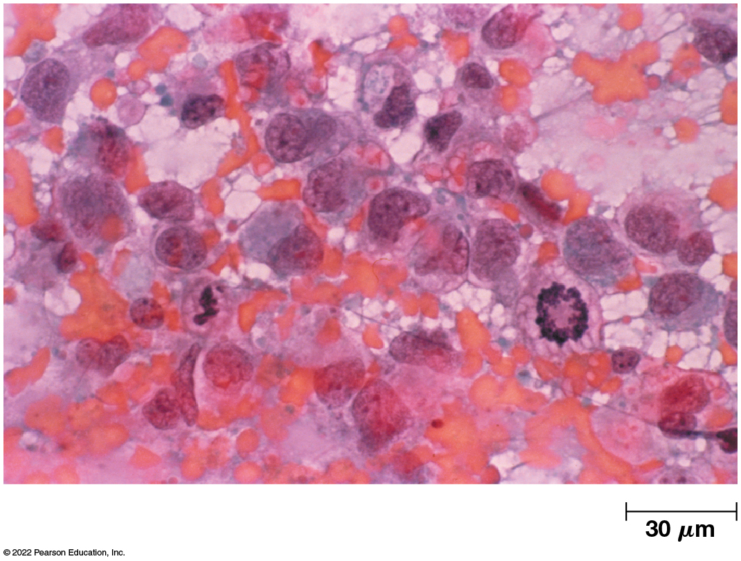
A Pap Smear Showing Endometrial Cancer
Figure 26.23 A Pap Smear Showing Endometrial Cancer.

Slide 138
Other Screening Techniques
Mammography uses a special X-ray technique to look for early signs of breast cancer.
Colonoscopy examines the colon for early signs of colon cancer.
The P S A test measures how much prostate-specific antigen is present in the bloodstream and is used to screen for prostate cancer.

Slide 139
Surgery, Radiation, and Chemotherapy Are Standard Treatments for Cancer
Strategies for treating cancer depend on the type of cancer and how far it has spread.
Most commonly, surgical removal of the primary tumor is followed—if necessary—by radiation and/or chemotherapy.

Slide 140
Radiation Therapy
Radiation therapy uses high-energy X-rays or other forms of ionizing radiation to kill cancer cells.
D N A damage caused by radiation activates the p53 pathway, which then triggers apoptosis. However, because p53 is frequently mutated in cancer, this pathway is not how most of the cells die.
Radiation also causes so much chromosome damage that cells cannot progress through mitosis and will die trying to divide.

Slide 141
Chemotherapy (1 of 3)
Chemotherapy usually uses drugs that kill dividing cells.
These fall into four categories:
Antimetabolites
Alkylating agents
Antibiotics
Plant-derived drugs

Slide 142
Chemotherapy (2 of 3)
Antimetabolites inhibit metabolic pathways required for D N A synthesis.
Examples include fluorouracil, methotrexate, fludarabine, pemetrexed, and gemcitabine
Alkylating agents chemically crosslink the D N A double helix.
Examples include cyclophosphamide, chlorambucil, and cisplatin

Slide 143
Chemotherapy (3 of 3)
Antibiotics inhibit DNA function by binding the DNA or inhibiting topoisomerases needed for replication
Examples include doxorubicin and epirubicin
Plant-derived drugs either inhibit topoisomerases or disrupt the microtubules of the mitotic spindle.
Examples include etoposide and Taxol

Slide 144
More Specific Treatment
Less toxic approaches are possible for cancers that require a specific hormone for growth.
Breast cancers that require estrogen for their growth can be treated with tamoxifen, which binds estrogen receptors and prevents activation.
Tamoxifen can both treat breast cancers and prevent occurrence in at-risk individuals.

Slide 145
Complications
Tumors tend to acquire mutations that make them resistant to the drugs used for treatment.
This multiple drug resistance occurs because cells start producing multidrug resistant transport proteins (ABC transporters).
These pump a wide range of hydrophobic drugs out of the cell.
Scientists are looking for ways to target cancer stem cells specifically.

Slide 146
Molecular Targeting Can Attack Cancer Cells More Specifically Than Chemotherapy
In molecular targeting, drugs are designed to specifically target the proteins critical to the cancer cells.
A well studied example of this is the monoclonal antibody Herceptin.
In rational drug design, chemical agents are identified that disrupt particular molecules mutated in cancer cells.

Slide 147
Anti-angiogenic Therapy
Sustained tumor growth relies on angiogenesis; thus, inhibitors of this process might be expected to be useful in cancer treatment.
Anti-angiogenic therapy is based on this idea.
The first drug approved for anti-angiogenic therapy was Avastin; short-term survival is improved in some types of cancer, but the benefits are usually temporary.

Slide 148
Using the Immune System to Target Cancer Cells
Immunotherapy exploits the ability of the immune system to recognize cancer cells.
Some success has been seen using bacillus Calmette-Guérin (B C G ).
This strain elicits a strong immune response and has been used to reduce cancer recurrence in bladder cancer.

Slide 149
Other Treatments
Interferon alpha and interleukin-2 (IL-2), two proteins that stimulate the immune system, have been used successfully in treating cancer.
Therapeutic vaccines that introduce cancer cell antigens into patients stimulate the immune system to attack cancer cells.
One, Provenge, is used to treat prostate cancer.

